Slide 1
2018 Seed Treatments Loveland Products
January 2018

Slide 2
Contents
Product | Pages
Seed Treatments by Crop (partial list) | 3-4
Awaken® ST | 5-8
Awaken® CoFlow | 9-19
Consensus® | 20-24
Dyna-Shield® Conquest™ | 25
Dyna-Shield® “utility” stand-alones Defuze™, Fludioxonil, Imidacloprid, Metalaxyl | 26
Dyna-Shield® Foothold® & Foothold Virock® (cereals) | 27-28
Dyna-Start® PBC (soybeans) | 29-37
Dyna-Start® Max (peanuts) | 38-39
Equity® VIP | 40-42
January 2018
2018 Loveland Seed Treatments
2

Slide 3
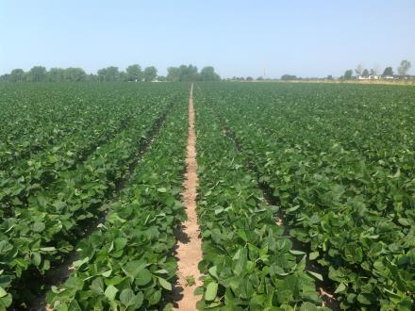
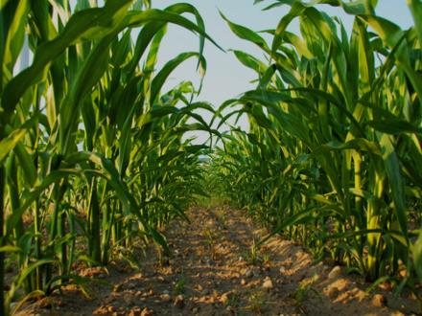
Seed Treatments by Crop
Soybeans
Corn
Peanuts
January 2018
2018 Loveland Seed Treatments
3

Slide 4
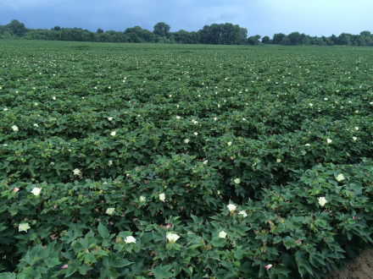
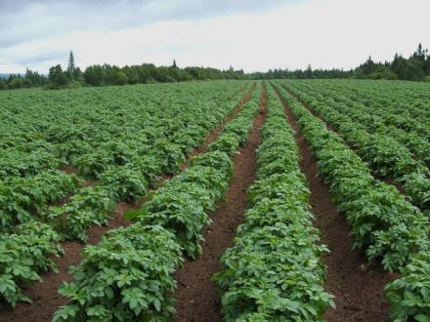
Seed Treatments by Crop
Wheat
Cotton
Potatoes
January 2018
2018 Loveland Seed Treatments
4

Slide 5
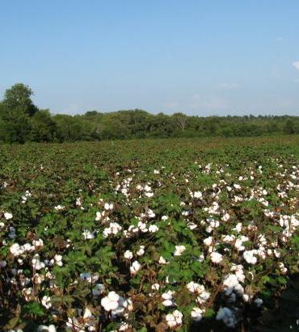
3

Slide 6
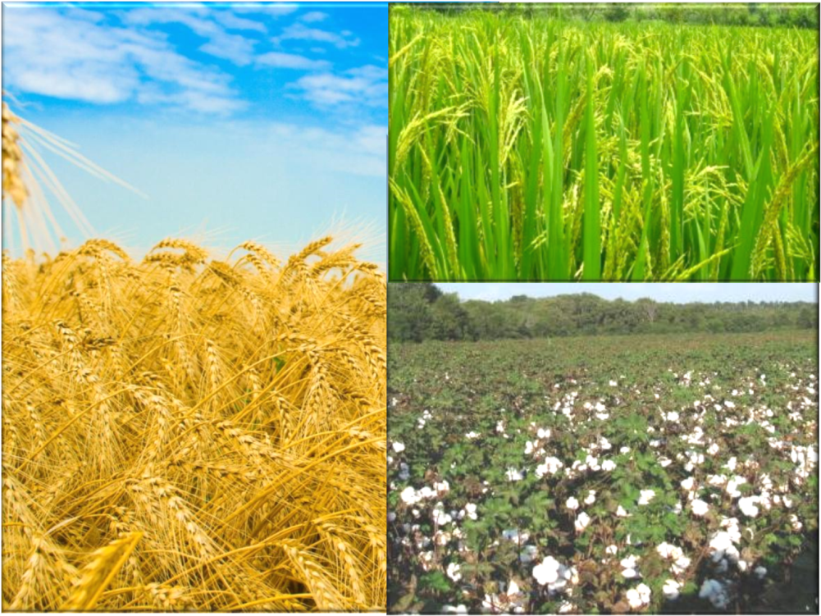
Early season growth
Stimulates early crop growth
Provides essential micronutrients
Extracts nutrients from the soil
January 2018
2018 Loveland Seed Treatments
6

Slide 7
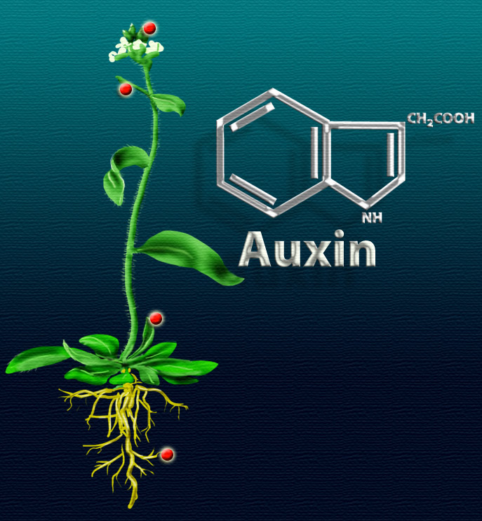
Complex of zinc ammonium acetate with potash + balanced micronutrients including boron, copper, iron, manganese, molybdenum and zinc
Contains 5% Zn:
Boosts production of plant hormone called auxin
(IAA or Indole Acetic Acid)
Auxin is well known to promote cell elongation
Increased root growth
Stimulates early crop growth
January 2018
2018 Loveland Seed Treatments
7

Slide 8
Extracts nutrients from the soil
Contains ACA Technology
Agricultural Crop Additive
Ammonium Acetate
Acts as an extraction agent to release nutrients tied up in the soil
Labeled crops: Cotton, Wheat, Barley, Triticale, Sorghum & Millet & Rice
NH₃
NH₃
O
H₃C-C-O
Zinc
O-C-CH₃
O
NH₃
NH₃
January 2018
2018 Loveland Seed Treatments
8

Slide 9
New for 2018
9

Slide 10
A nutritional and polymer seed treatment designed specifically for field corn.
Stimulates Early Corn Growth
Can increase planter flowability and improve seed placement
Can decrease dust-off for good seed treatment stewardship
January 2018
2018 Loveland Seed Treatments
10

Slide 11
January 2018
2018 Loveland Seed Treatments
11

Slide 12
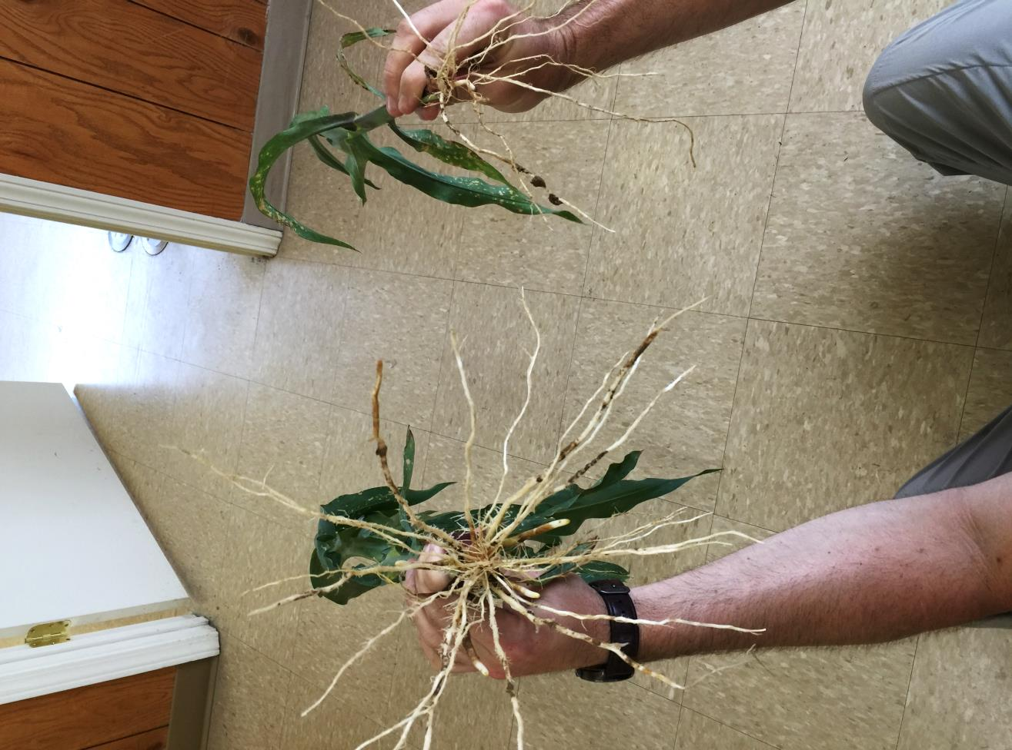
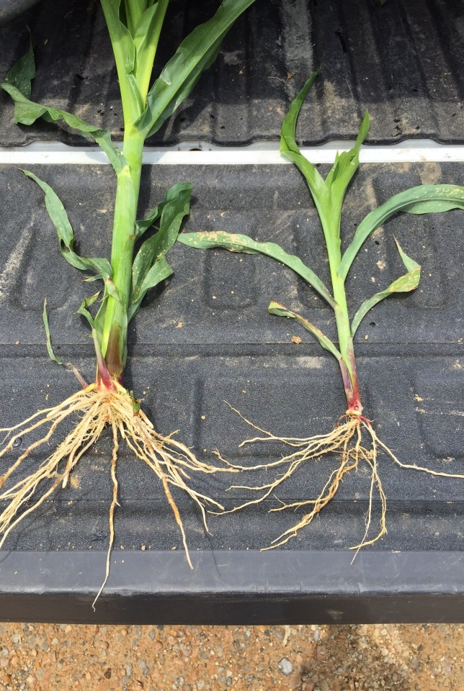
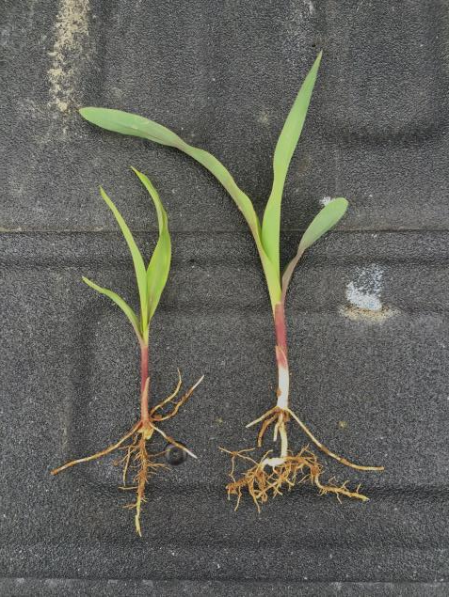
Better Early Growth
Complexed micronutrient package including: Nitrogen, Boron, Copper, Iron, Manganese, Molybdenum and Zinc
January 2018
2018 Loveland Seed Treatments
12

Slide 13
January 2018
2018 Loveland Seed Treatments
13

Slide 14
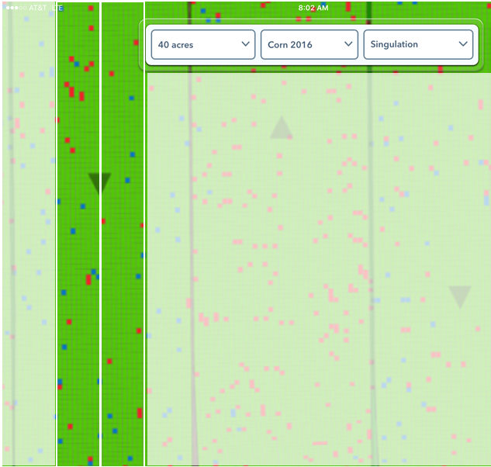
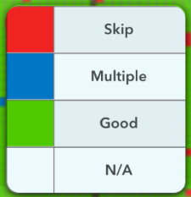
Side by Side Corn Singulation Study Kentucky, 2016
Standard
Seed
Treatment
Standard
Seed
Treatment
With
Awaken
CoFlow
With
Awaken
CoFlow
Standard
Seed Treatment
May decrease yield by 4%*
May decrease yield by 14%*
* Yield impact of skips and doubles estimated by C. Brewer, Pioneer Agronomy, 2009.
Delta Farm Press http://www.deltafarmpress.com/corn-skipsdoubles-can-rob-you-yield
January 2018
2018 Loveland Seed Treatments
14

Slide 15
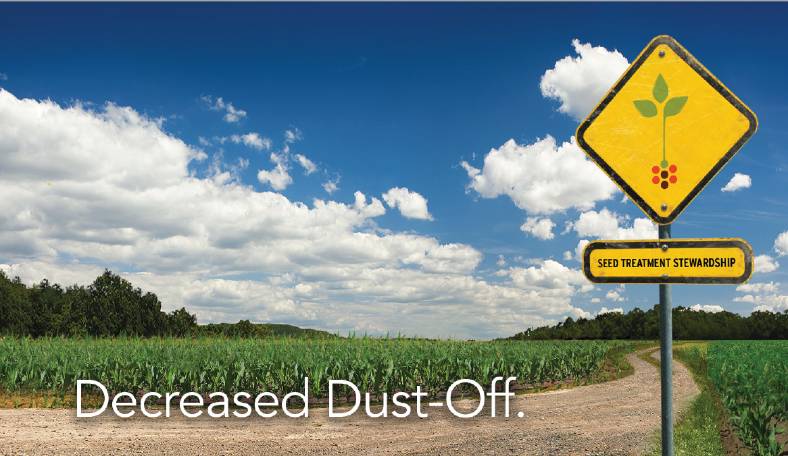
January 2018
2018 Loveland Seed Treatments
15

Slide 16
Decreased Dust-Off
Includes a polymer specifically designed for use with seed corn
“Seed treatments, including neonicotinoid, insecticide treatments, are effective tools to provide the necessary protection of seeds for a strong, healthy start.”
“It is essential that those who treat, handle, transport, and plant treated seed manage them properly and in accordance with the label instructions to minimize the risk of pesticide exposure to non-target organisms.”
January 2018
2018 Loveland Seed Treatments
16

Slide 17
January 2018
2018 Loveland Seed Treatments
17

Slide 18
Better Yields
Bu/A Corn Yield Benefit Over Standard Seed Treatment
35 Trial Sites, 2015-2017, Average by State
January 2018
2018 Loveland Seed Treatments
18

Slide 19
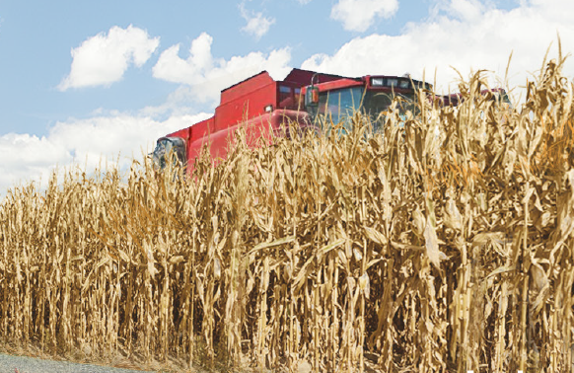
January 2018
2018 Loveland Seed Treatments
19

Slide 20
A unique seed treatment designed to promote
Faster germination
Better early root development
Plant stress protection
January 2018
2018 Loveland Seed Treatments
20

Slide 21
Faster germination
Chitosan
Promotes gene expression
Increases hydrolase production
Better utilization of seed nutrients
January 2018
2018 Loveland Seed Treatments
21

Slide 22
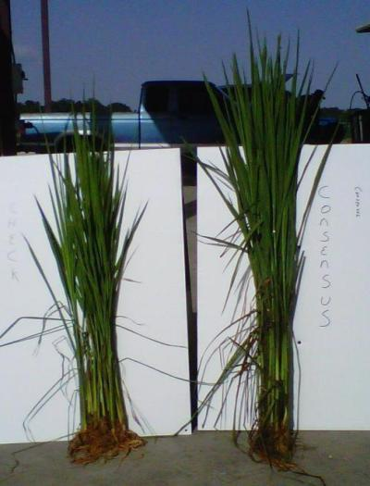
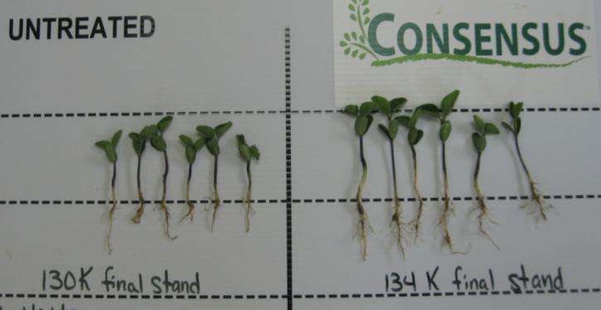
Early root development
Indole-3-butyric acid (IBA)
Promote lateral roots and root hairs
Enhance water and soil nutrient absorption
….for faster seedling growth and better stress resistance
January 2018
2018 Loveland Seed Treatments
22

Slide 23
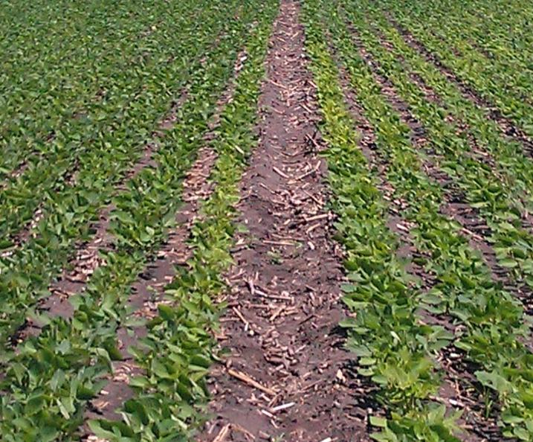
Protection from plant stress
Salicylic Acid
Induces Systemic Acquired Resistance (SAR)
Triggers natural plant defenses
Allows for greater plant vigor and survivability
January 2018
2018 Loveland Seed Treatments
23

Slide 24
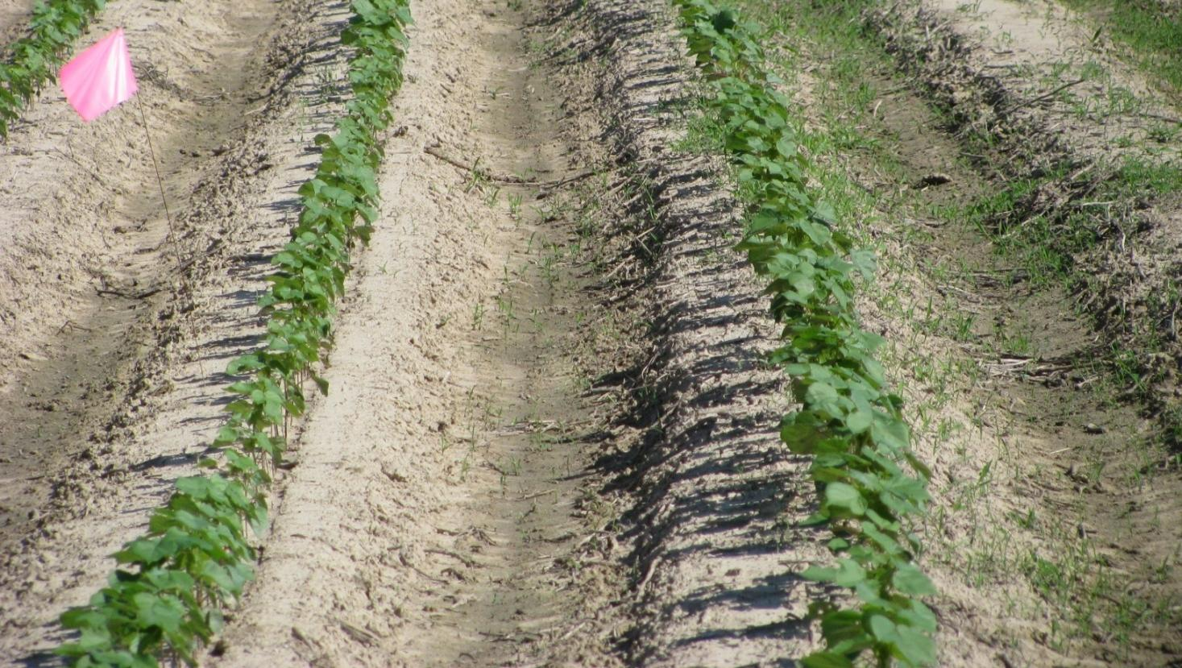
Untreated Check
For use on soybeans, cotton, small grains and more than 40 additional labeled crops
0.33 – 1.0 fl oz/cwt
3

Slide 25
4-way insecticide/fungicide seed treatment
Imidacloprid insecticide
Metalaxyl fungicide
T-methyl (thiophanate methyl) fungicide
Fludioxinil fungicide
Soybeans
1.867 fl oz/140K seeds
4.0 fl oz/cwt
Dry beans, snap beans & chickpeas
4.0 fl oz/cwt
January 2018
2018 Loveland Seed Treatments
25

Slide 26
Utility Seed Treatments
3.09 lb Difenoconazole fungicide – same a.i. as Dividend®
4 lb Fludioxinil fungicide - same A.I. as Maxim®, Spirato®
5 lb Imidacloprid insecticide– same a.i. as Gaucho® 600/Gaucho Grande, Acceleron® IX-409, Attendant® 600, Senator® 600
2.65 lb Metalaxyl fungicide - same a.i. as Allegiance®; can use as substitute for Apron XL®
January 2018
2018 Loveland Seed Treatments
26

Slide 27
Wheat Treatments Offering
Tebuconazole + Metalaxyl fungicides. Same a.i.s. as Raxil® MD.
Most commonly applied at 6.5 fl oz/cwt Labeled rate range 5.0 - 6.5 fl./oz./cwt.
Tebuconazole, Metalaxyl & Fludioxinil fungicides plus Imidacloprid insecticide. Same a.i.s as Raxil® MD, plus fludioxinil (equivalent to Maxim®) plus imidacloprid (Gaucho equivalent)
Most commonly applied at 5.0 fl oz/cwt Labeled rate range 3.4 - 5.0 fl oz/cwt.
January 2018
2018 Loveland Seed Treatments
27

Slide 28
^{CEREALS SEED TREATMENT} ^{EFFICACY GUIDE}
Cruiser Maxx® Vibrance™ Cereals
CruiserMaxx® Cereals
Stamina®
EverGol® Energy
Dividend Extreme®
Dividend®
Vbrance® Extreme
Stamina® F3
Common Bunt | E | E | N | N | E | E | E | E | E | E | E | E
Dwarf Bunt | F | F | N | N | G-E | G-E | G-E | G-E | G-E | F | F | F
Flag Smut | E | E | N | N | E | E | E | E | E | E | E | E
Loose Smut | E | E | N | N | G-E | G-E | G-E | G-E | G-E | F | F | F
Pythium Seed Decay/ Seed Damping Off | E | E | E | N | N | E | N | E | E | N | E | E
Common Root Rot | G | G | N | N | G | G | G | G | G | G | G-E | G-E
Fusarium Root Rot | G | G | N | N | G | G | G | G | G | G | G | E
Seed Decay Fungi | G | G | N | N | G | G | G | G | E | G | G-E | G-E
Powdery Mildew | G | G-E | N | N | G | G | G | G | G-E | G | G | E
Leaf Rust | F-G | F-G | N | N | F-G | F-G | F-G | F-G | F-G | P | P | F-G
Stem Rust | F-G | F-G | N | N | F-G | F-G | F-G | F-G | F-G | P | P | F-G
Strip Rust | P | P | N | N | P | P | P | P | P | P | P | P
Take All | P | P | N | N | P | P | P | P | P | P | P | P
Seedling Bligh | P | P | N | N | P | P | P | P-G | P-G | P | P | P
Wireworm | N | G | N | G | N | N | G | G | N | N | N | N
28

Slide 29
Unique soybean seed treatment containing:
Dyna-Start™ Soybean Inoculant
Dyna-Start™ Extender Liquid
Seed Treatment
January 2018
2018 Loveland Seed Treatments
29

Slide 30
Features
Dyna-Start™ Soybean Inoculant
1 x 10¹⁰ cfu/ml Bradyrhizobium japonicum
= 1.2 million rhizobia/seed
Dyna-Start™ Extender Liquid
Enhanced inoculant viability on the seed
EPA-Registered plant growth regulator
Low 1.9 oz/100 lbs application rate
January 2018
2018 Loveland Seed Treatments
30

Slide 31
Why use an inoculant?
Ensure optimized nitrogen-fixing nodulation to allow a crop to achieve its full genetic potential
A 70 bushel soybean crop requires nearly 300 pounds of nitrogen per acre
The most efficient method of providing this N need is through the biological fixation process that occurs within the soybean nodules
January 2018
2018 Loveland Seed Treatments
31

Slide 32
What does do?
Three components provide complementary modes of action
Chitosan creates faster germination through increased utilization of seed storage nutrients
Salicylic Acid provides SAR (Systemic Acquired Resistance) to trigger a seedling’s natural defenses against pathogens, allowing greater plant vigor and survivability
Indole-3-butyric acid (IBA) can promote the development of lateral roots and root hairs, for enhanced water and soil nutrient absorption
January 2018
2018 Loveland Seed Treatments
32

Slide 33
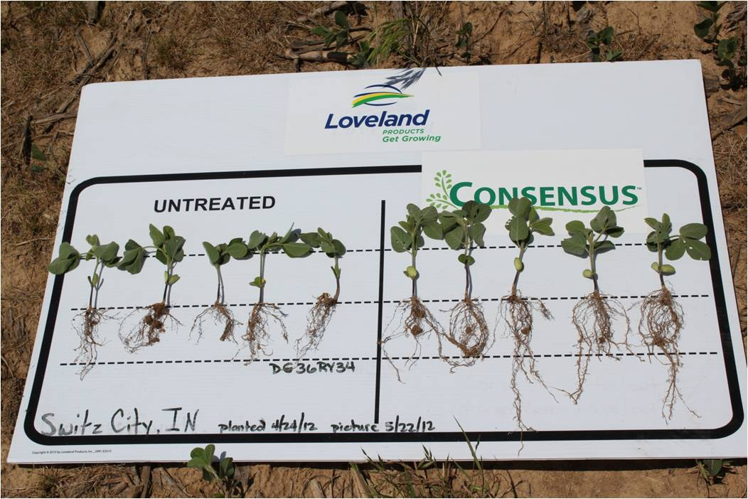
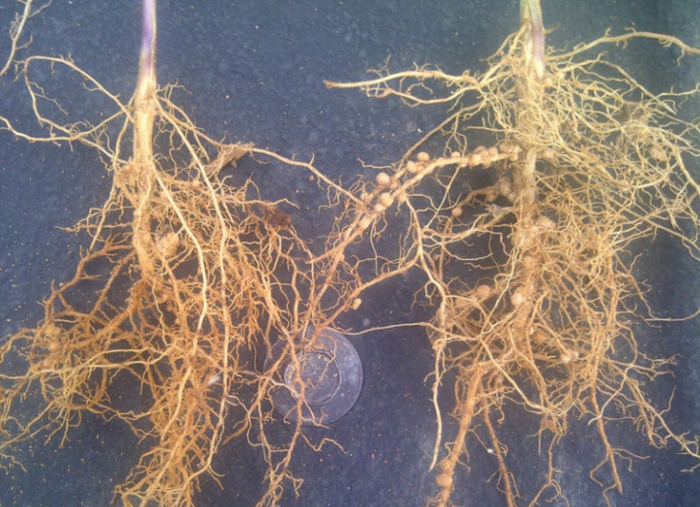
Benefits
Faster germination & root development
Plant stress protection
Superior nitrogen fixation for yield potential
Minimized bridging
Flexibility in planting timing
January 2018
2018 Loveland Seed Treatments
33

Slide 34
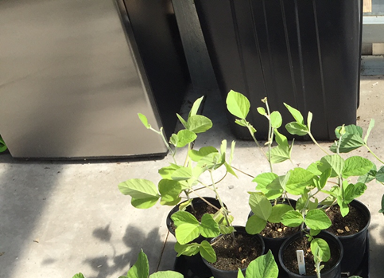
Untreated
Control
34

Slide 35
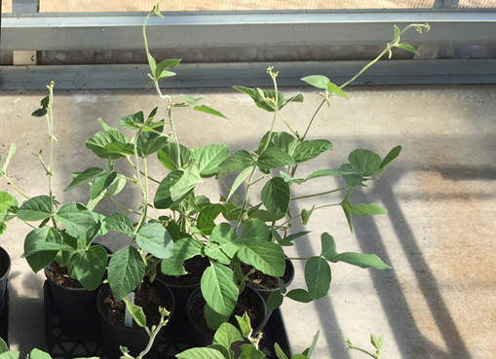
Untreated
Control
+ Rhizobia inoculant
+ Rhizobia alone:
Nitrogen fixation, deep green color
35

Slide 36
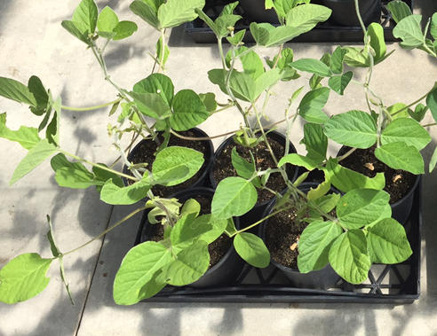
Untreated
Control
+
+ alone: Plant growth stimulation
36

Slide 37
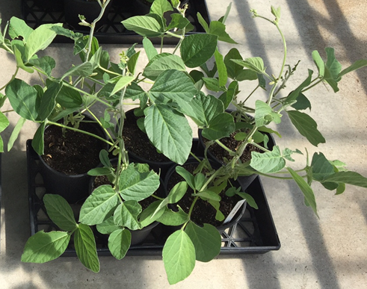
Untreated
Control
Rhizobia
37

Slide 38
Peanut Inoculant
LCO Promoter Technology® that enhances natural growth processes :
Advanced emergence producing healthier, faster developing plants
Earlier and increased nodule development for improved nitrogen fixation
Earlier fruit set reduces the risk of temperature related damage
Increased yield and grade for improved return on investment
January 2018
2018 Loveland Seed Treatments
38

Slide 39
Peanut Inoculant
Multi-year performance 2003-2011
Yield
Lbs/A
January 2018
2018 Loveland Seed Treatments
39

Slide 40
Five-way formulation of:
Cruiser® (thiamethoxam) insecticide
Apron® XL (mefenoxam) fungicide
Maxxim® (fludioxonil) fungicide
Mertect® (thiabendazole) fungicide
Vibrance® (sedaxane) fungicide
New SDHI category chemistry
“Best in class Rhizoctonia control”
Additional mode of action for resistance management
Healthier, stronger stems and foliage for stress resistance
“VIP” = CruiserMaxx® Vibrance plus TBZ (thiabendazole)
Phomopsis control
Additional fusarium activity
January 2018
2018 Loveland Seed Treatments
41

Slide 41
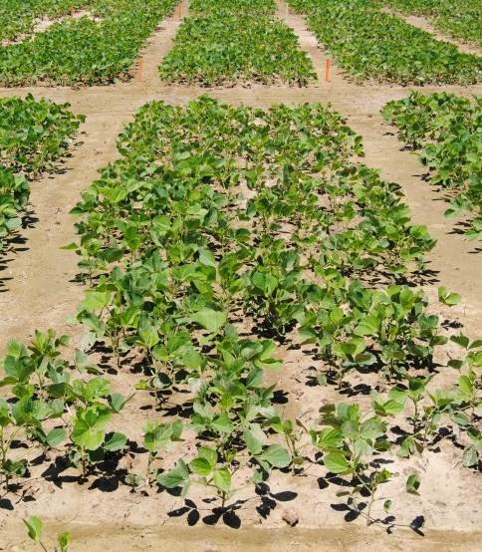
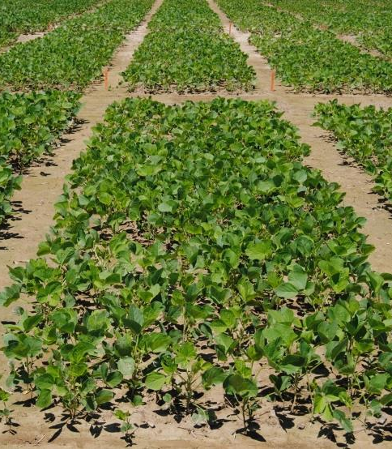
UNTREATED
140,000 plants/a
Packaging: 15 gal kegs
Rate: 1.38 fl oz/140K seeds
15 gal keg treats 1,391 units
Pre-colored RED
EQUITY VIP
169,725 plants/a
January 2018
2018 Loveland Seed Treatments
42

